Slide 1
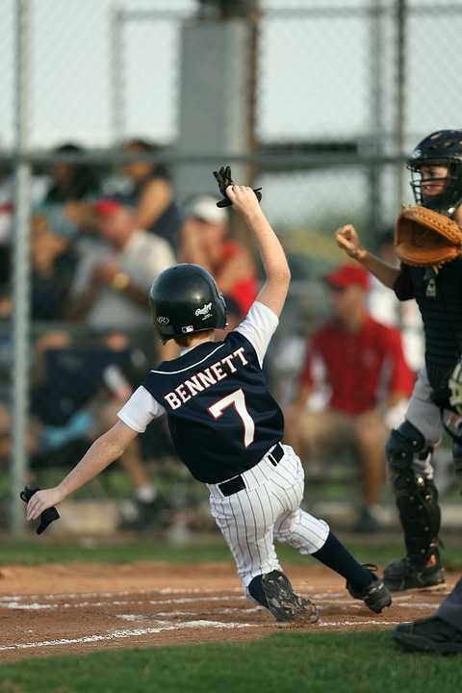
7.00 The runner
Ed Bradford & John watson

Slide 2
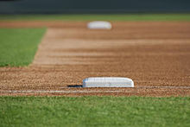
7.01 A Runner acquires the right to an unoccupied base until retired
or forced to vacate it for another runner. Once the Pitcher is on the
Pitcher’s plate, the runner may not return to a previously occupied
base.
7.02 A Runner shall touch 1st, 2nd, 3rd, and Home Plate in order. If forced to
return, the Runner shall retouch in proper order, unless there is a dead
ball.

Slide 3
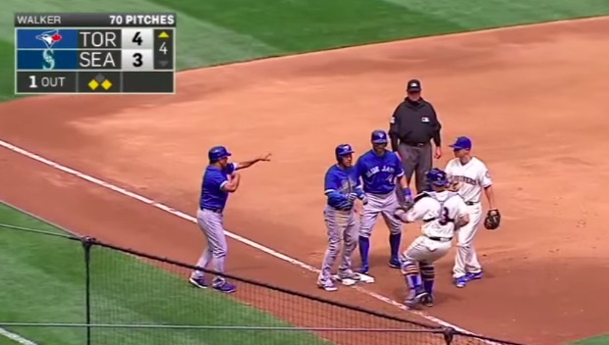
7.03 Two Runners can’t occupy the same base:
The preceding runner is entitled to the base, and the “Trailing” runner is out when tagged.
This is true except in the unlikely event that the lead runner did not advance after having been forced to vacate by the batter-runner (in which case he would be out if tagged, or if the next base he was supposed to advance to is tagged).
Ex. – Bases loaded. Batted
ground ball. R3 retreats to 3rd
after advancing half way to HP

Slide 4
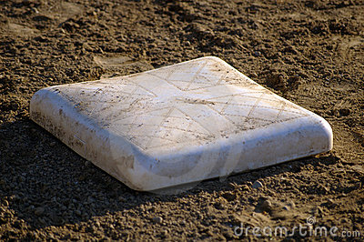
7.04 Runners advance one base when:
The batter-runner‘s advance to 1st forces runners to advance.
A Fielder, after catching a fly ball, falls into Dead Ball territory, or…
A fielder falls down in dead ball territory after his momentum carries
him there while he is in possession of the ball. - Dead Ball. Runners are awarded one base.

Slide 5
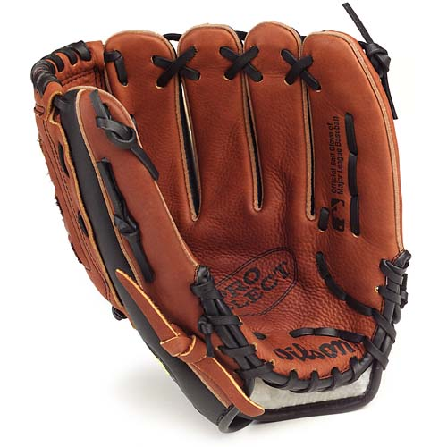
7.05 - Equipment Throwing at Batted or Thrown Ball/ Runners advance:
4 Bases - if in Umpire’s judgment, a Batted Ball that is deflected by a thrown glove, hat, etc. would have cleared the fence
3 Bases - if a Batted Ball is deliberately touched by equipment detached from its proper place (Ball remains in Play)
2 Bases - if a Thrown Ball is deliberately touched by equipment detached from its proper place (Ball remains in Play)
1 Base - if a Pitched Ball is deliberately touched by catcher’s detached equipment
Note: If live ball is not actually touched - you’ve got nothin’ !
1 Base - if a pitch or pickoff throw from the Rubber
goes into Dead Ball Territory
1 Base - batter on Ball 4, or dropped 3rd Strike,
if pitched ball lodges in fence, or Umpire’s gear.

Slide 6
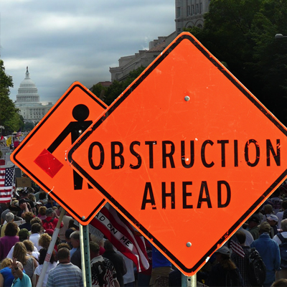
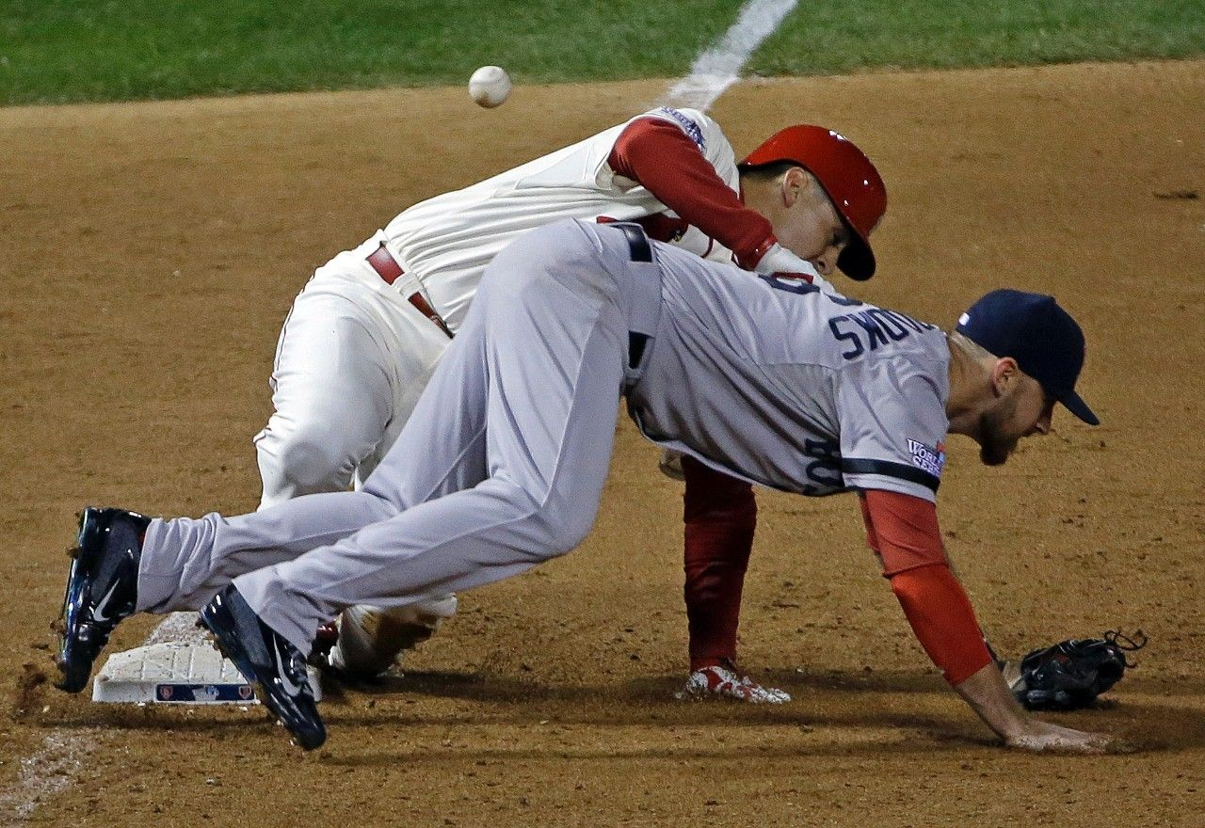
Is the act of a Fielder who, when not in possession
of the ball, impedes the progress of any Runner. It
shall be called on any Defensive player who blocks
off a base, baseline, or Home Plate from a Base
Runner while not in possession of the ball. A
“Fake” Tag is Obstruction.

Slide 7
7.06 OBSTRUCTION:
If a play is being made on the Obstructed Runner or if the Batter-Runner
is obstructed before touching 1st base, the ball is “Immediately Dead”. Place all runners at bases they would have reached. Note: The obstructed runner is awarded at least one base beyond the base last legally touched.
b] If no play is being made on the obstructed runner, ball is ”Delayed Dead”.
Call it… and wait! When no further play is possible, place runners at bases
they would have reached had the obstruction not occurred (if any).
Remember : If ball remains live and a Runner attempts to advance beyond the awarded base, he does so at his own risk. [Judgment]

Slide 8
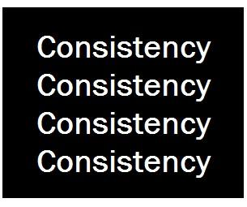
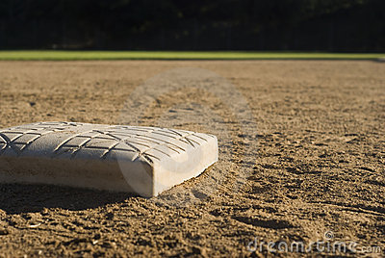
A Fake Tag is: when a Fielder is at a base and takes an action that simulates an
attempted tag, which causes the runner to slow down or slide. Faking a catch while
not near a base or the base path is not a Fake Tag (Judgement) so,
if a Fielder goes through with the motion of catching a ball and then simulates a tag, it
is Obstruction. It should be called- There is no WARNING.

Slide 9
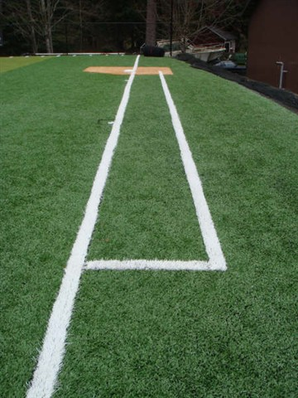
7.08 - The Runner is out for:
Running 3 ft. out of the baseline in order to avoid a tag – Note: Runner is not out if trying to avoid a fielder attempting to make a play.
After touching 1st base, the runner leaves the baseline,
obviously giving up all effort to advance to next base.
The Runner does not slide or attempt to get around the
fielder who has the ball and is waiting to apply a tag.
The Runner (Majors) slides head first to advance.

Slide 10
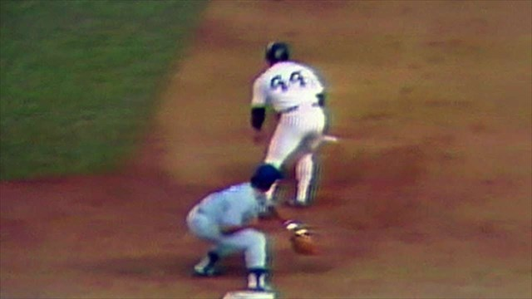
7.08 con’t - The Runner is out for:
Intentionally interfering with a thrown ball.
Interfering with a fielder attempting to make a play
on a batted ball - Intentional or not !
Note: No Contact is needed
If tagged while off a base with a live ball.
Exception: over-sliding or over-running at 1B.
Approved: Could be on Base on Balls
If base breaks away after runner has reached base
safely, Runner can go to the original position of base
or to the base itself.

Slide 11
7.08 con’t- Runner is out:
Failure to retouch a base after a fly ball is caught by a fielder, and the Runner or the appropriate base has been tagged (and appealed properly). Base runners can legally retouch as soon as a fair fly is touched or foul fly ball is caught.
Touched by a Fair ball before the ball passes an infielder or is touched by Pitcher.
Immediate Dead Ball. No runner may score, no runners advance unless forced to do so.
EXCEPTION: While in contact with a base, runner is touched by Infield Fly
Note: If touched by Infield Fly while off base, both
Runner and Batter are out.
Note: If 2 Runners touched by the same fair ball,
only 1st touched is out since ball is
“Dead” immediately.

Slide 12
7.08 con’t- The Runner is out if:
While attempting to score at home - the Batter interferes with catcher or other
fielder ( with less than 2 outs ).
Same play with 2 outs, the Batter is declared out and no run scores.
Passing a preceding runner – Ball remains live…
After acquiring a base, runs bases in reverse order to confuse defense or
make a travesty of the game. Call “time” immediately - and declare the runner out.

Slide 13
7.08 con’t- Leaving 1st base after over-running or over-sliding. If attempting to advance
to 2nd, the Runner is out, if tagged. Same situation, but heads to Dugout or toward a
Defensive position and fails to return to 1st base immediately, thus abandoning the
bases - Runner is out on appeal, if tagged or the base is tagged.
7.08 Final- Runner out …
When runner fails to touch home plate and makes no attempt to return to the plate - Umpire makes no call. The Catcher (or other Fielder) touches/steps on plate, and appeals to Umpire for decision.
Note: This rule only applies when Runner is headed to the Dugout and makes no attempt to get back.

Slide 14
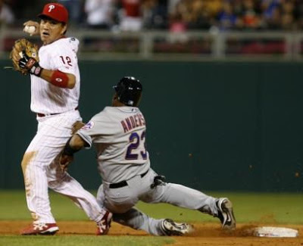
7.09- It is Interference when:
D - Any member(s) of the Offense stand or gather around any base to which a Runner is advancing to confuse, hinder, or add difficulty on the Fielders. Runner is out by the action of his Teammate(s)
E - Any Batter or Runner who was just retired, hinders or impedes any following play being made on a runner. That Runner is out by the action of Teammate.

Slide 15
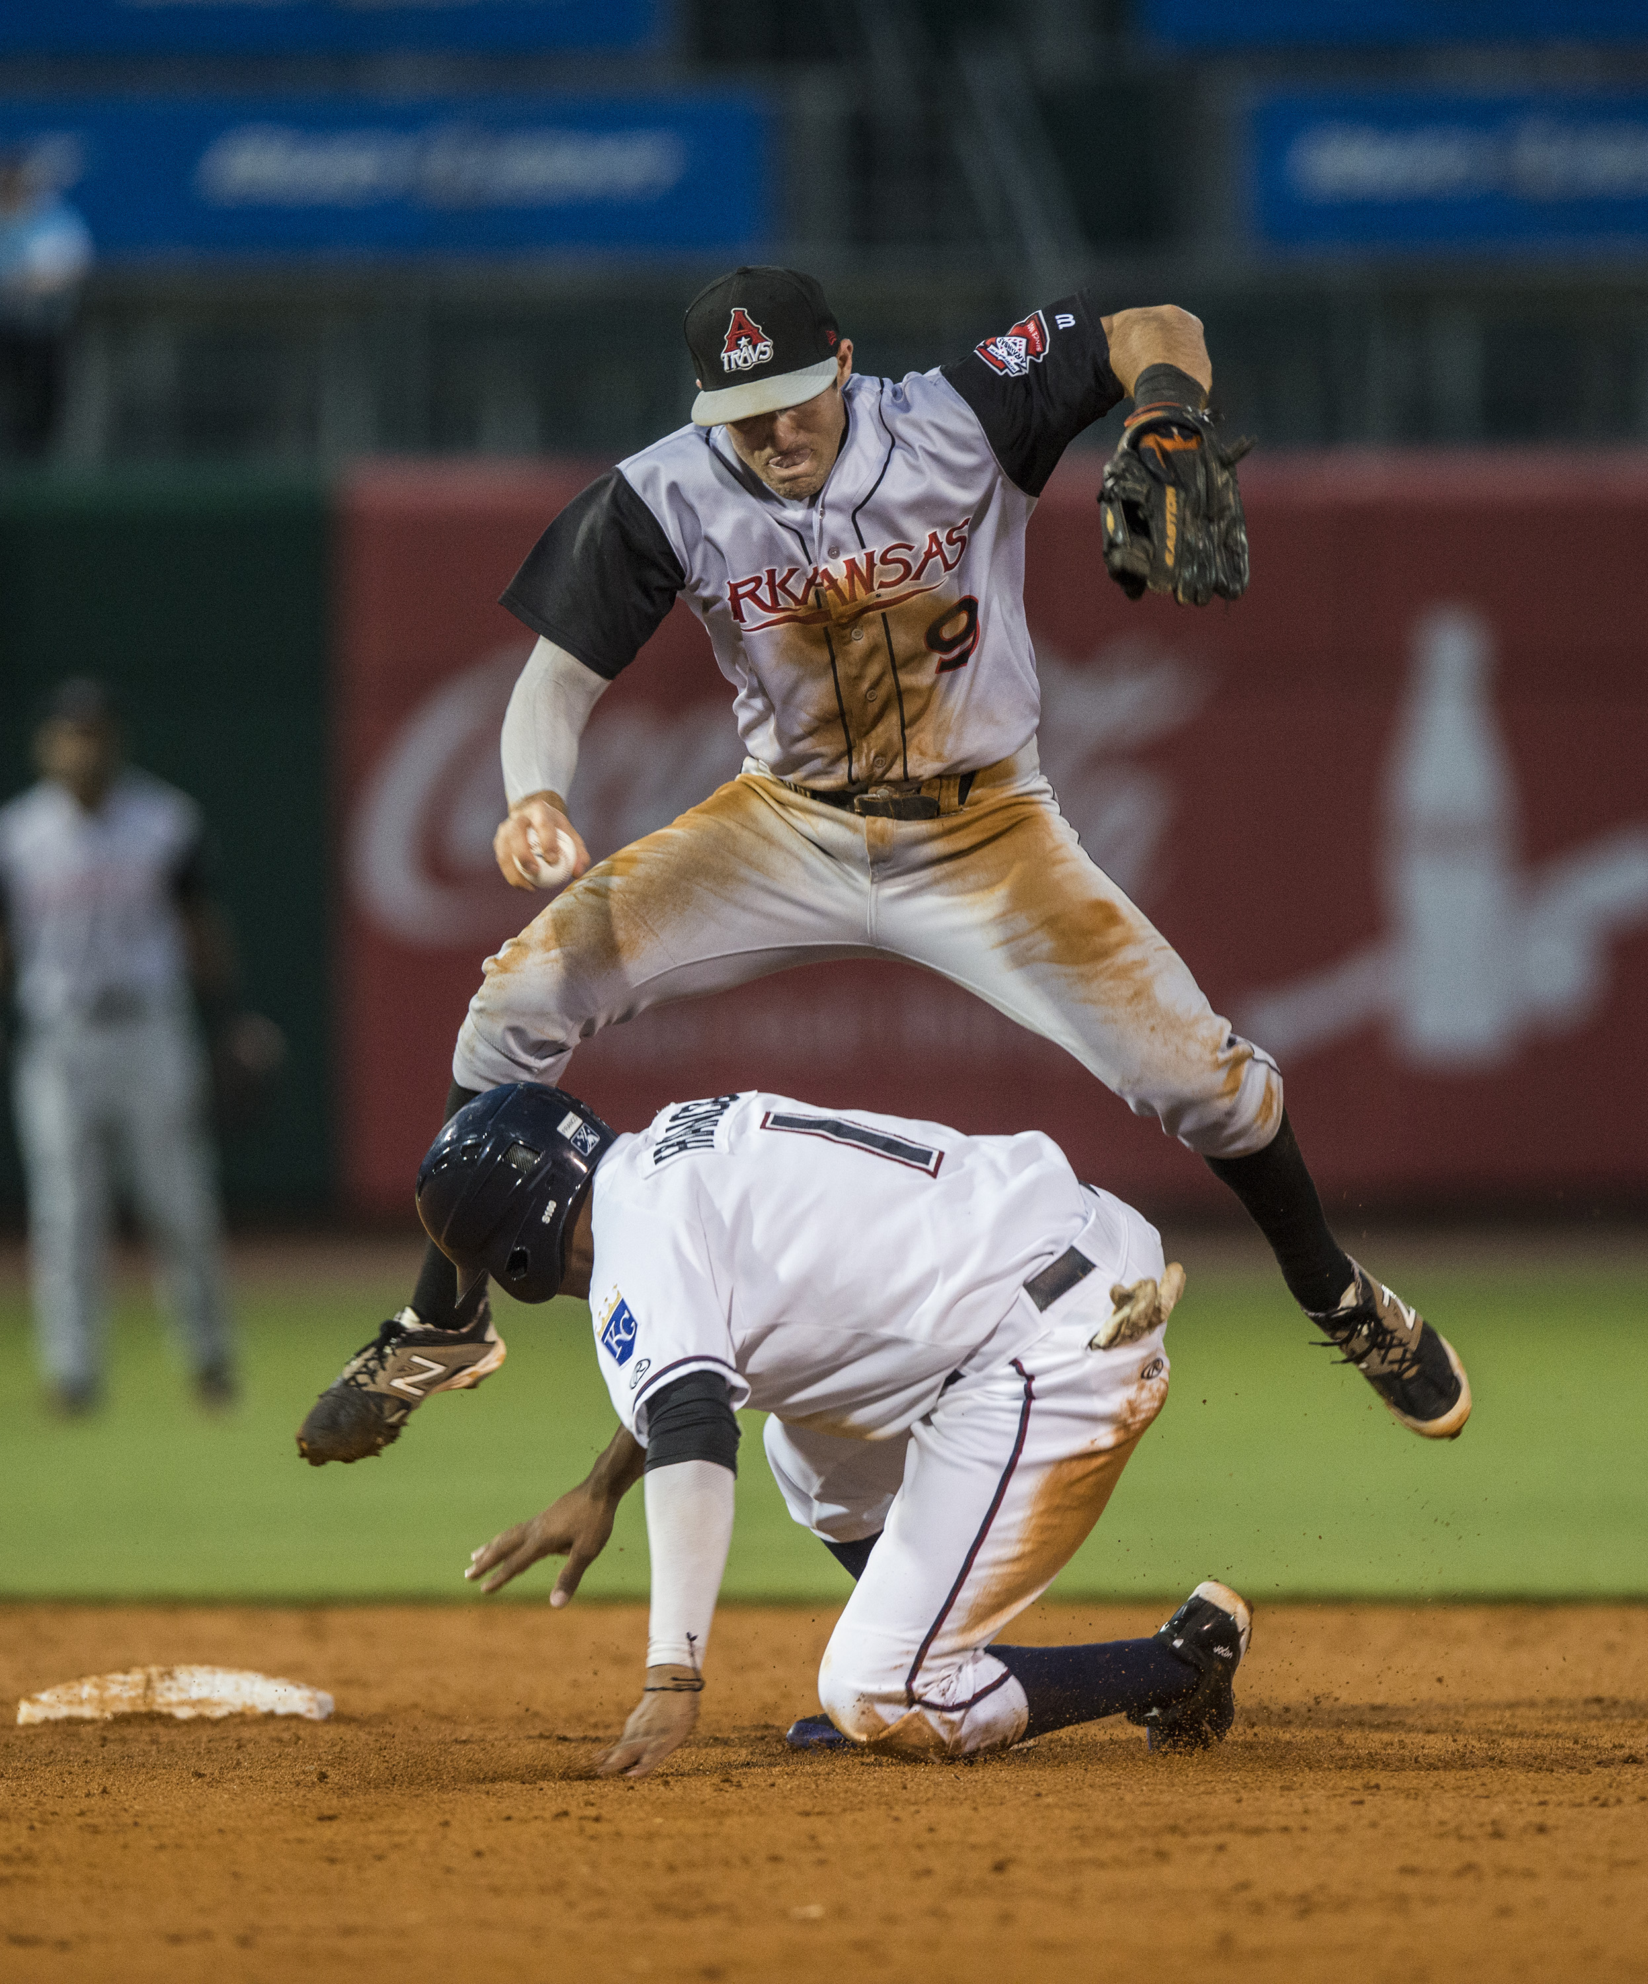
7.09 con’t
F- A Runner deliberately interferes with a Batted ball or a Fielder making a play with obvious intent to break up a Double Play. The Ball is dead, Runner and Batter-Runner are both out. No Runners may advance or score.
G- A Batter-Runner deliberately interferes with a
Batted ball or a Fielder making a play, the ball is
Dead, both Batter-Runner and the Runner closest
to home are declared out, no matter where the
Double Play may have been possible.

Slide 16
7.09 con’t-
H- Assisted Runner by Base Coach- physically assists the Runner in returning to or leaving a base. ( High - 5 is OK! )
AR- If play is being made on Assisted Runner, the Runner is out, and all other Runners return to base occupied at the time of interference. If no play on Assisted Runner, Runner is out and play continues (Delayed Dead Ball)
I- Runner on 3rd Base, the Base Coach leaves the box and acts in a manner to draw a throw

Slide 17
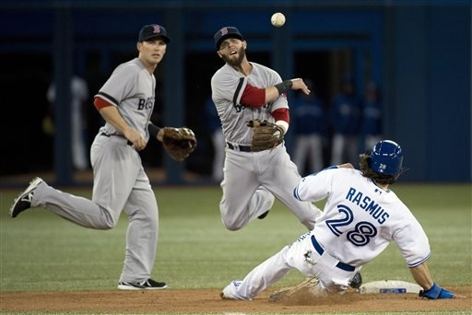
7.09 J- The Runner fails to avoid a fielder who is attempting a play or intentionally
interferes with a thrown ball. With 2 or more infielders, Umpire will
determine which Fielder is entitled to Interference Rule.

Slide 18
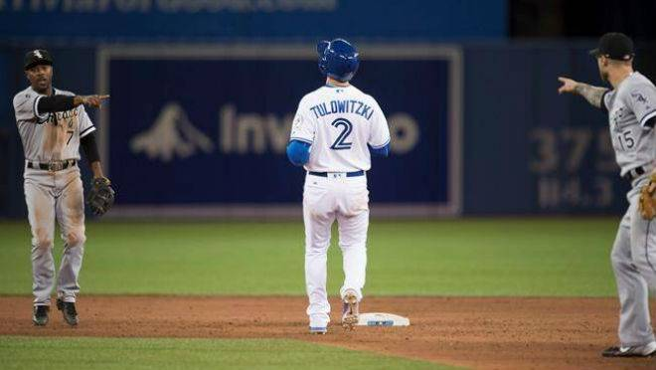
7.09 con’t- K- A fair ball touches the Batter or Runner in Fair Territory before touching
Pitcher or passing a Fielder. If Ball goes through or by the infielder and then touches
a Runner right behind said infielder and No Other Infielder had a chance to make a
play, the Runner is not out. If the Runner intentionally touches same batted ball on
which Infielder had missed a play, the Runner is now out for Interference.

Slide 19
7.10 Appeals
Tag Ups- No Flying Starts
B) While advancing or returning to a base, Runner
fails to touch each base in order
AR - Can’t retouch after a Following Runner has scored
- No return when ball is dead.
The Runner fails to touch
the plate, and makes
no attempt to return,
enters Dugout or
other Dead Ball area.

Slide 20
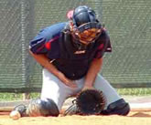
Any Appeal must be made before the next Pitch, Play, or Attempted Play. If a violation
Occurs during a play which ends a half inning, the Appeal must be made before all
Defensive Players have left Fair territory. Exception: Retrieving the ball that went into
Foul Territory in order to make an Appeal, or a catcher making an appeal who never
Entered Fair Territory are adjudged to be properly appealed.

Slide 21
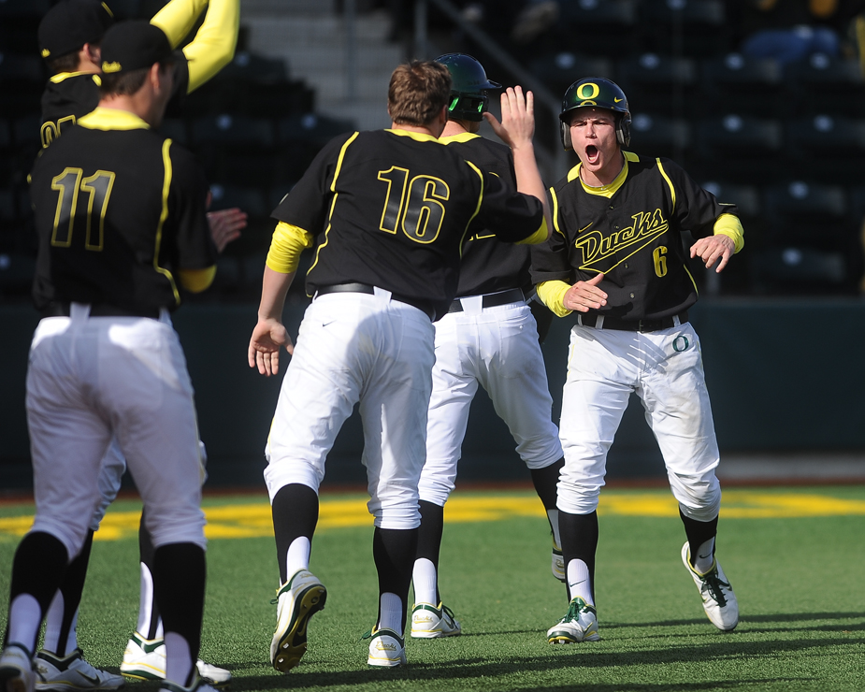
7.14 Special Pinch Runner….
Any Player in the Line-Up may be removed for a Special
Pinch Runner, one time during the game.
Pinch Runner cannot currently be in the Line-Up.
Can’t be used if League is using Continuous Batting Order.
Notes:
- Record who got pinch run for!!!!
- Continuous means Everybody has to be in
the Line-Up.

